Slide 1
HR Analytics

Slide 2
Key Performance Indicators (KPIs)
Total Employees → 22K
Remote Employee Rate → 24.75%
Headquarter Employee Rate → 75.25%
Average Age → 38.43
Insights:
The workforce is primarily based on-site, with over 75% at headquarters.
The average age of employees is 38.43, indicating a mid-career workforce.
A significant remote proportion (25%) reflects flexibility in work arrangements a trend influenced by modern work culture or possibly post-pandemic policies.

Slide 3
Line Chart – Hire Rate by Year
Years range from 2000 to 2020
Hire rates vary slightly but remain mostly around 4.5%–5.5%
There was a peak at 5.14% in 2003, and a slight decline towards 2020 (4.56%)
Insights:
Hiring has remained consistent, showing steady workforce growth.
Slight dips might correspond to economic downturns
(e.g., 2008–2009 or 2020 pandemic).
The company shows long-term hiring stability,
which is a positive retention indicator.

Slide 4
Donut Chart – Employee Gender Distribution
Female: 12K (53.54%)
Male: 10K (46.46%)
Insights:
A slightly female-dominant workforce – indicates good gender balance.
Company could explore gender-based role distribution for inclusion metrics.

Slide 5
3 Bar Charts
By Race:
Highest: White (6.3K)
Followed by Two or More Races, Black, Asian
Lowest: Native Hawaiian, American Indian, Other
Insight:
Company may focus on improving diversity & inclusion policies, especially to attract underrepresented races.

Slide 6
2. By Department:
Highest: Engineering (6.7K)
Others: Sales, Business Dev, Support, Product, etc.
Insights:
Engineering is clearly the core functional area. Suggests the company is tech or product-driven.
Opportunity: Rebalance or grow departments like Legal, Finance, or HR if underrepresented.

Slide 7
3. By State (location State):
Top State: Ohio (18K employees)
Others State: PA, IL, IN, KY, WI
Insight:
Strong state-based concentration (mainly Ohio) could lead to location-based risks or opportunities for expansion.
Company can consider diversifying office presence geographically.

Slide 8
Terminations by Year:
Valid Past Years (2001–2024):
Steady increase in terminations over time, suggesting higher workforce
mobility or company growth.
Highest terminations:
2021 → 205 exits
2022 → 186 exits
2024 → 178 exits (until current data)
2019 – 2023 show consistently high exits per year (160–205)

Slide 9
Visualize the data using PowerBI

Slide 10
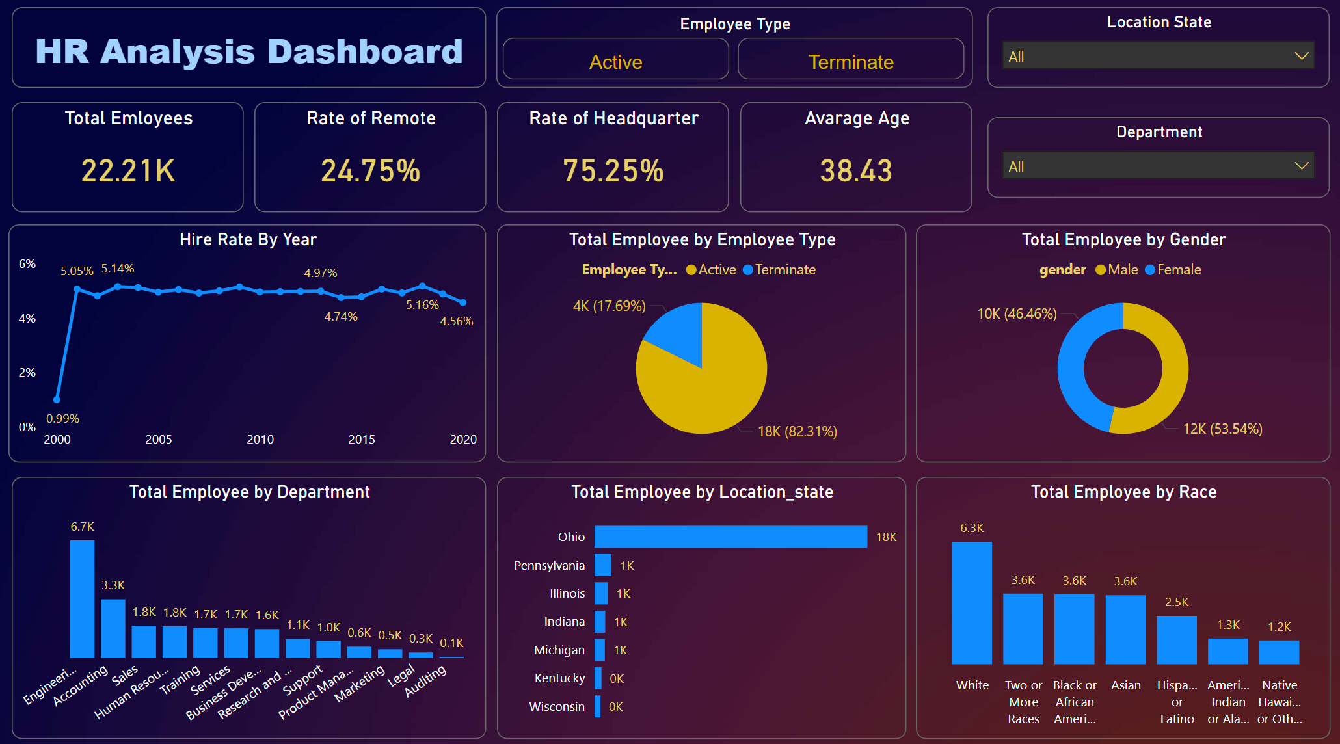

Slide 11
Analyze All Features – Derived Insights
Headquarters Dominance: 75% of employees work on-site; opportunity to explore remote talent pools.
2.Diversity Gaps: While there's racial representation, more focus could be placed on minority group recruitment.
3.Age Profile: With an average age near 38, succession planning and career development are crucial.
4.Gender Balance: Encouraging, though role-level analysis could reveal deeper insights.
5.Departmental Skew: Engineering leads by a huge margin – good for a tech company, but may indicate imbalance.
6.Hire Trends: Stable hiring with slight dips; monitoring post-2020 trends is important.

Slide 12
Final Recommendations to the Company
Leverage the remote workforce more effectively, especially for minority or diverse regions.
2.Review hiring trends by department to identify future workforce needs.
3.Invest in inclusion and diversity strategies to boost underrepresented groups.
4.Use the dashboard insights to shape strategic decisions on HR policies, training programs, and geographic expansion.

Slide 13
Thank
You

